Slide 1
The Tour and Travel Website
Using Full Stack Technologies

Slide 2
Introduction
The tour and travel website to book a tour from anywhere in the world by a single dynamic website which will help the user to know all about the places and tour details in a single website. The admin can add packages to the website from a certain travel agents and hotels by create a tour page. Then the users can sign in and book each project, they can be confirmed by the admin in their manage booking page. The user can see the confirmation in their my booking page. It is a easiest platform for all travelers which can be easily booked and know the all details. Tour Management system is a dynamic website for tourism business. It is dynamic and responsive web design. It is also called travel technology solution for agencies & tour operation. Nearly Everyone goes on a vacation for this ‘a Tourism management system’ would play a vital role in planning the perfect trip. The tourism management system allows the user of the system access all the details such as location, events, etc. The main purpose tourism companies to manage customer and hotels etc. The system can also be used for both professional and business trips.

Slide 3
Objective & Motivation
The tours and travel website is a web based application and maintains a centralized repository of all related information. The Objective of this project is to develop a system that automates the process and activities of a travel agency and customer details. The purpose is to design a system using which one can perform all operations related to travelling and sightseeing.
Travel is like a meditation. Nowadays people want to travel more and more. But due to various problems people are not able to go to the correct places and also not able to manage the expenses as well. We wanted to provide this solution with which we can solve the various above mentioned problems. We are also traveller and this project is like a solution we’re finding for our own problems.

Slide 4
Technologies Used
HTML
HTML (Hypertext Markup Language) is the code that is used to structure a web page and its content. For example, the content could be structured within a set of paragraphs, a list of bulleted points, or using images and data tables. As the title suggests, this article will give you a basic understanding of HTML and its functions.
CSS
Cascading Style Sheets (CSS) is a style sheet language used for describing the presentation of a document written in a markup language such as HTML. CSS is a cornerstone technology of the World Wide Web, alongside HTML and JavaScript.

Slide 5
Technologies Used(contd.)
JavaScript (React.js)
JavaScript (JS) is a lightweight, interpreted, or just-in-time compiled programming language with first-class functions. While it is most well-known as the scripting language for Web pages, many non-browser environments also use it, such as Node.js, Apache CouchDB and Adobe Acrobat. JavaScript is a prototype-based, multi-paradigm, single-threaded, dynamic language, supporting object-oriented, imperative,, etc.
Bootstrap
Bootstrap is a free and open-source CSS framework directed at responsive, mobile-first front-end web development. It contains CSS- and (optionally) JavaScript-based design templates for typography, forms, buttons, navigation, and other interface components.Bootstrap is the seventh-most-starred project on GitHub, with more than 142,000 stars, behind freeCodeCamp (almost 312,000 stars) and marginally behind Vue.js framework.

Slide 6
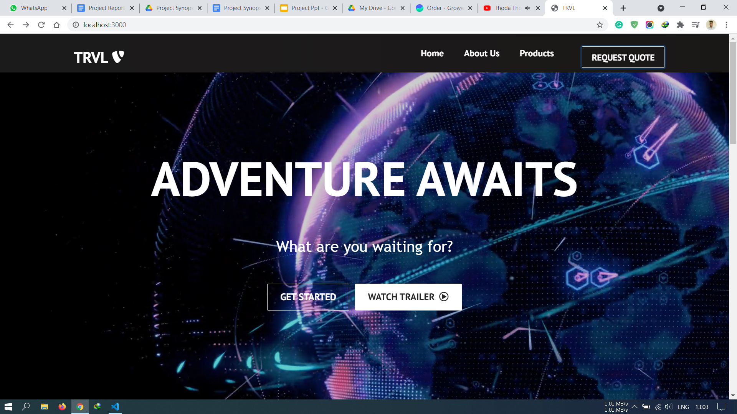
User Interface

Slide 7
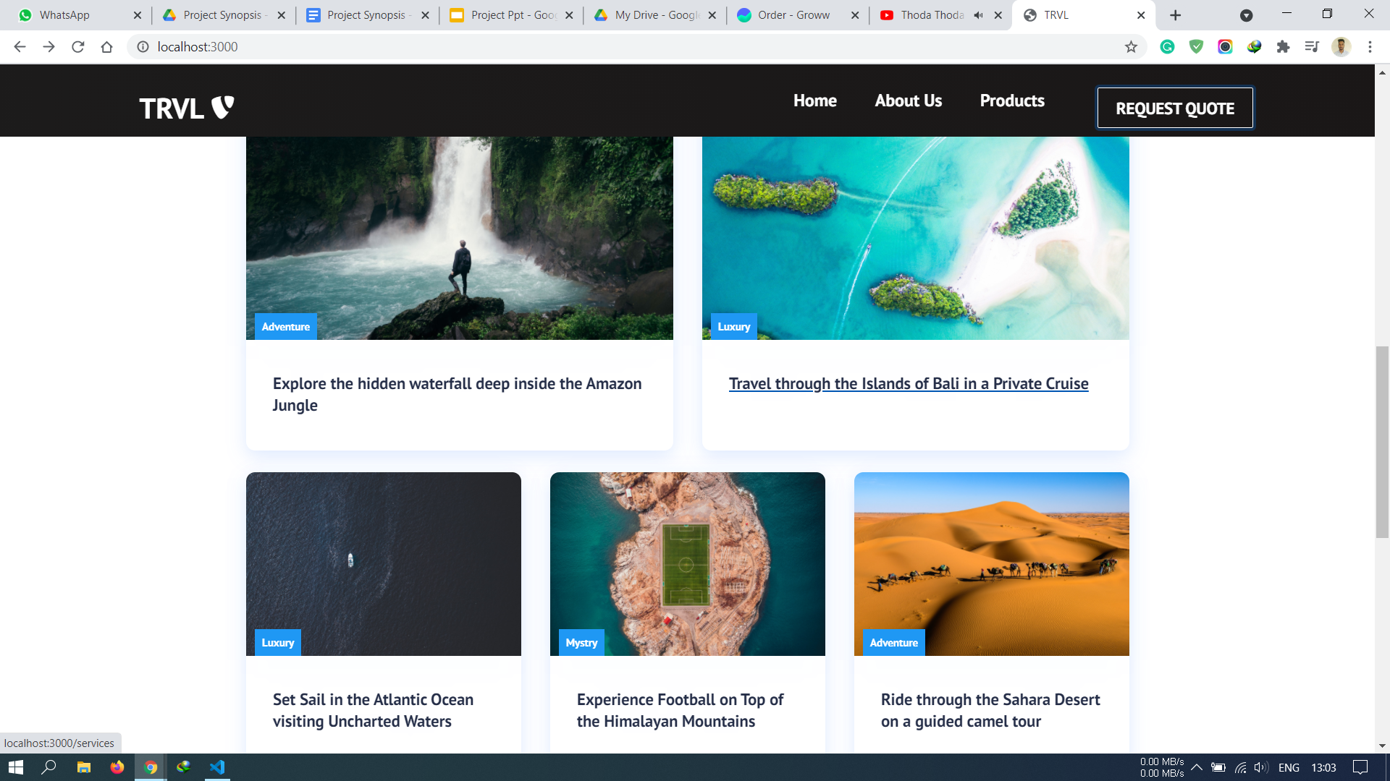
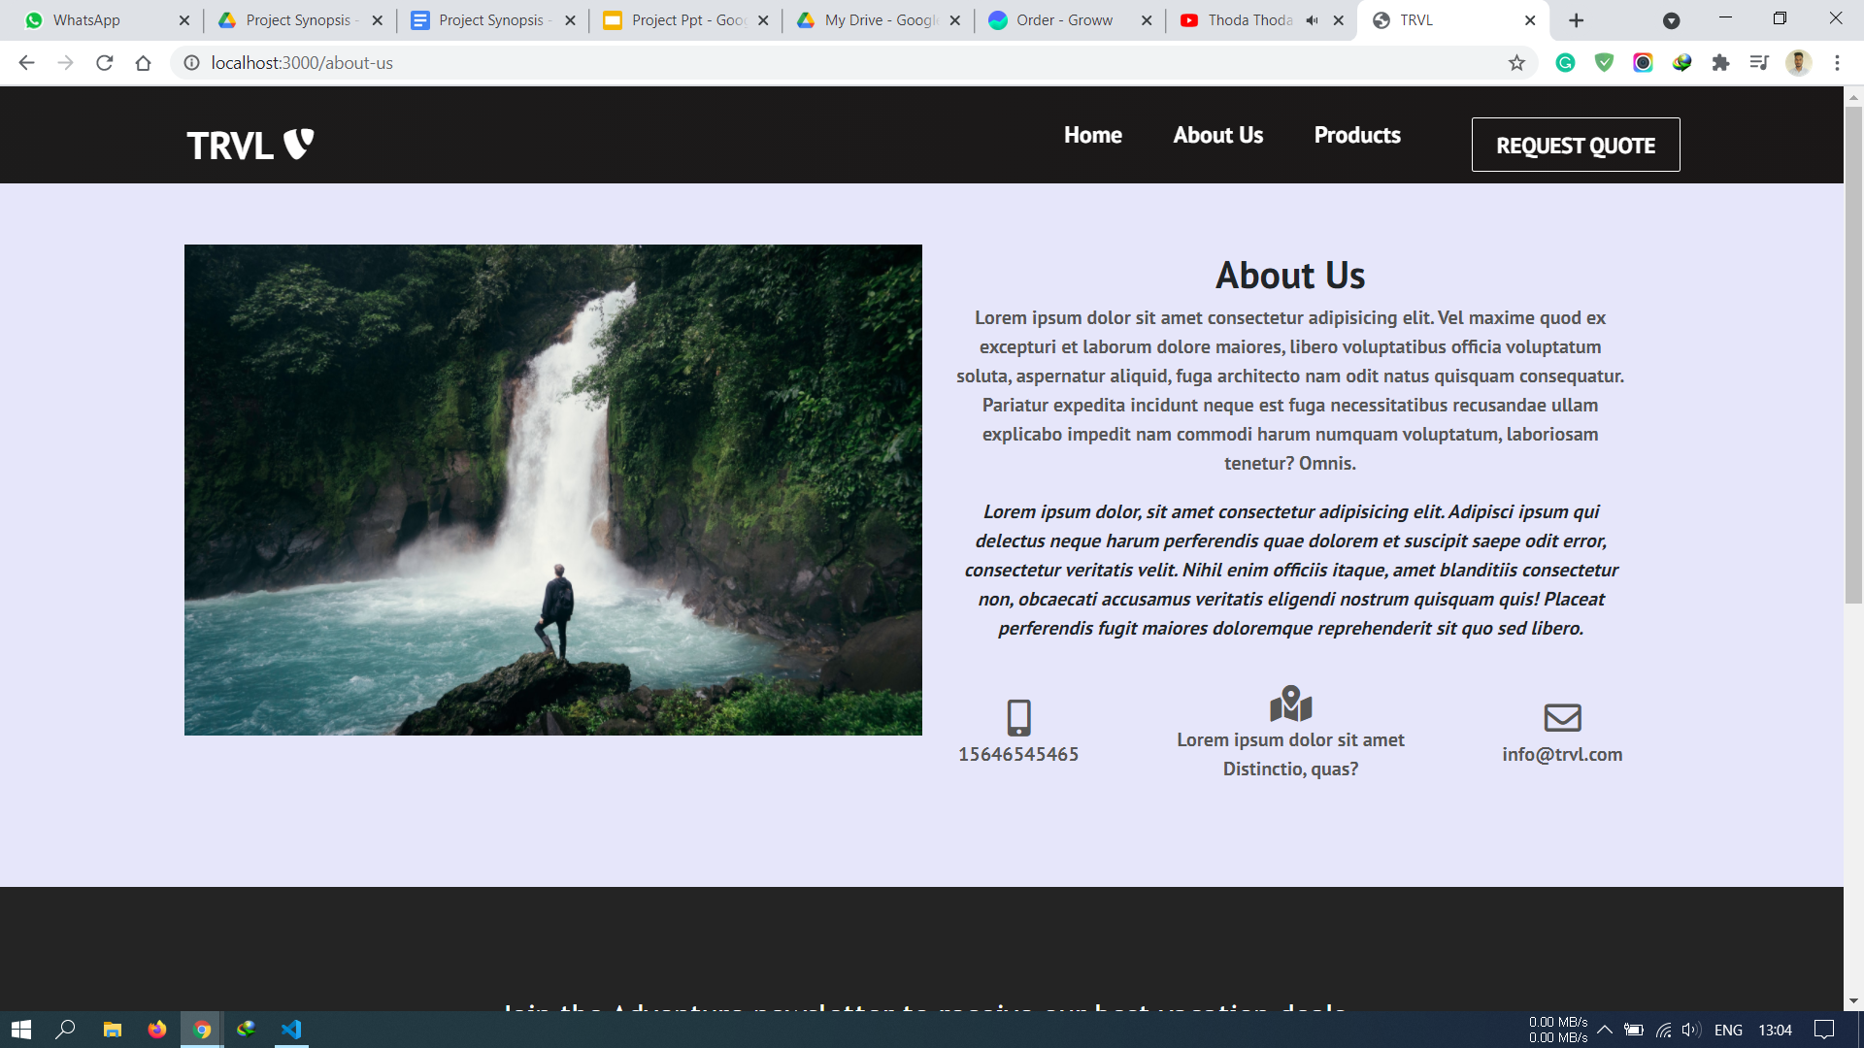
User Interface (cont.)

Slide 8
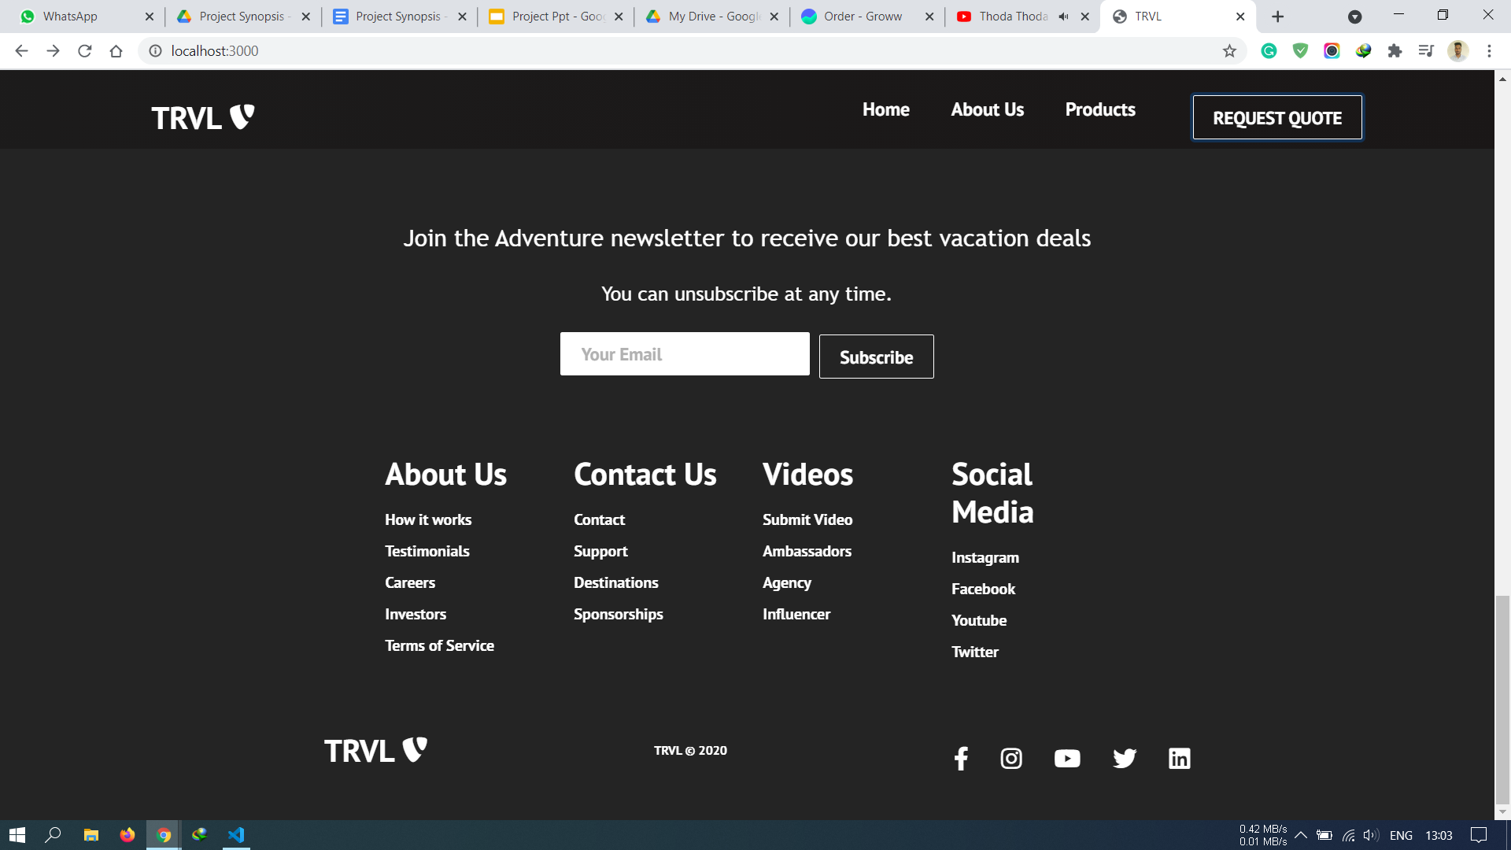
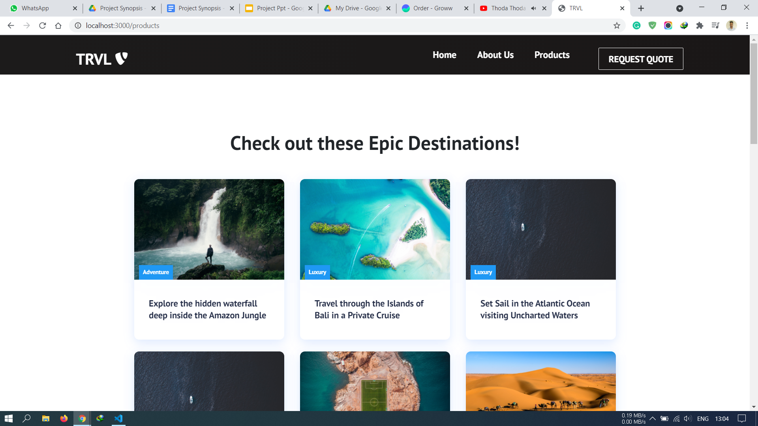
User Interface (cont.)

Slide 9
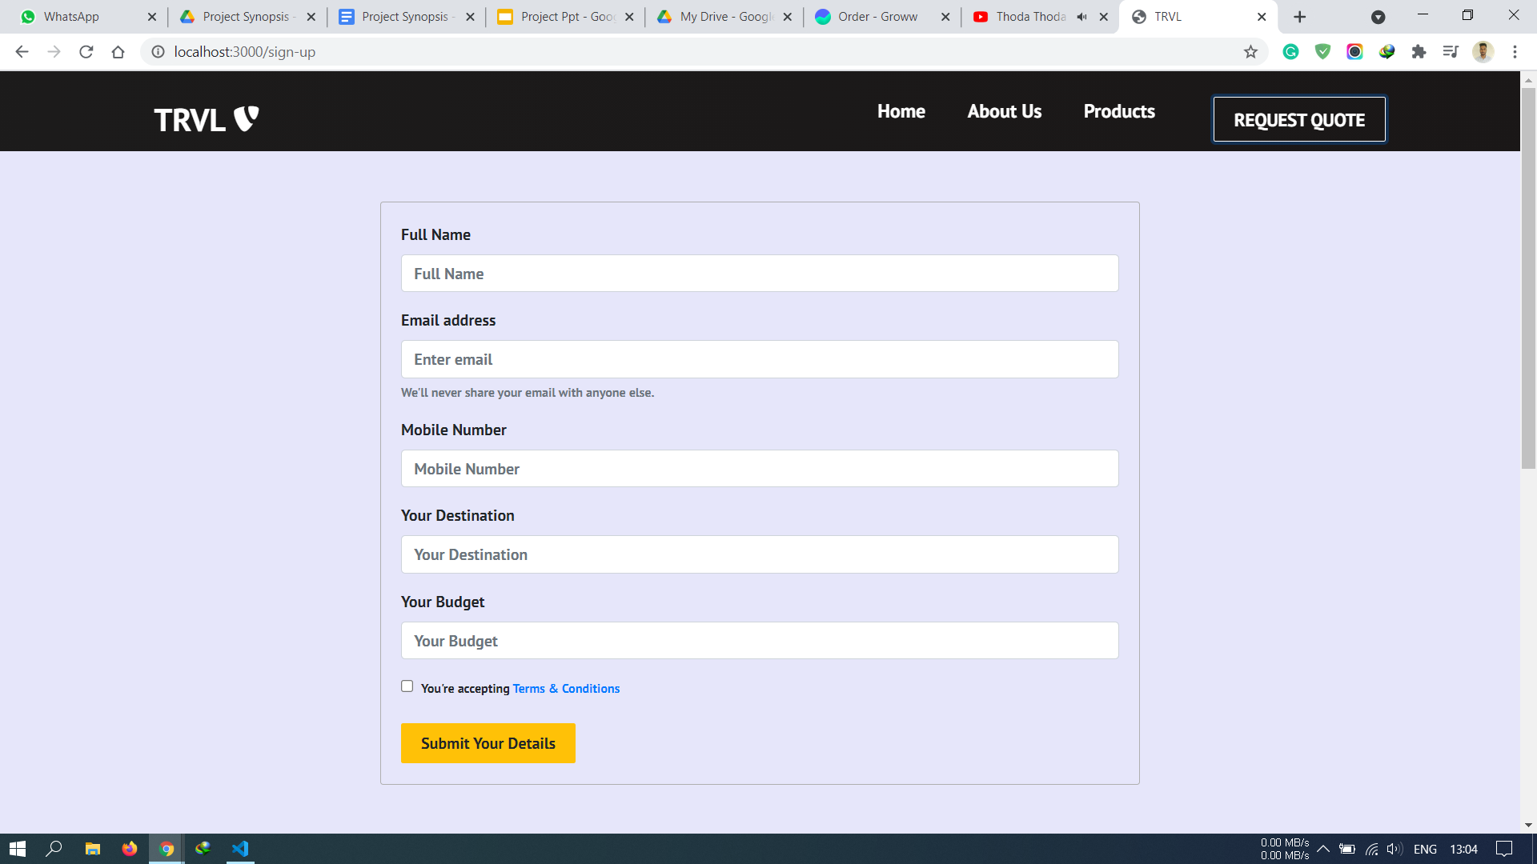
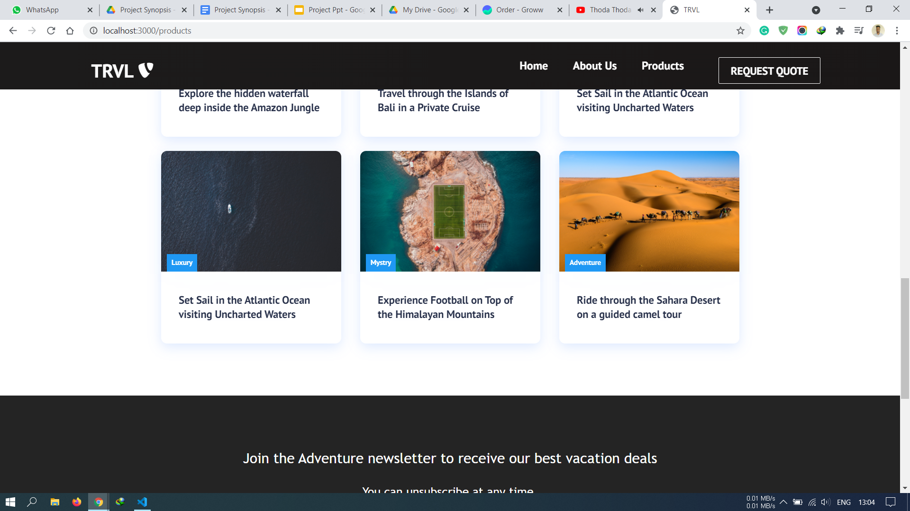
User Interface (cont.)

Slide 10
Thank You

